Slide 1
Evaluation: Inspection, Analytics and Model
Samia Arshad
Computer Science Department

Slide 2
Introduction
Methods that are based on understanding users
Knowledge codified in heuristics
Heuristic Evaluation and Walkthroughs
Data collected remotely
Analytics and A/B testing
Models that predict users’ performance
Predictive modeling (Fitt’s Law)

Slide 3
Inspection
Done by experts or researchers who are knowledgeable about both interaction design and the needs and typical behavior
of users.
Heuristic Evaluation
Cognitive Walkthrough

Slide 4
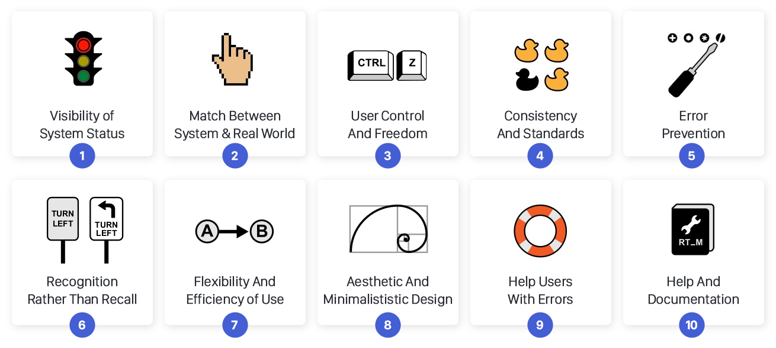
Heuristic Evaluation

Slide 5
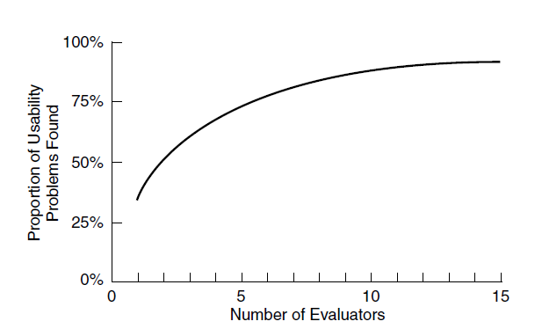
Heuristic Evaluation
Empirical tests were conducted suggesting that 3–5 can typically identify up to 75 percent of the total usability problems.

Slide 6
Heuristic Evaluation – Web Design
Clarity
Minimize Unnecessary Complexity and Cognitive Load
Provide Users with Context
Promote a Pleasurable and Positive User Experience
(Budd, 2007)

Slide 7
Heuristic Evaluation – Stages
A briefing session, in which the user researchers are briefed about the goal of the evaluation.
The evaluation period, in which the user researchers typically spend 1–2 hours independently inspecting the product
The debriefing session, in which the researchers discuss their findings with designers to prioritize the problems and give suggestions for solutions.

Slide 8
Cognitive Walkthrough - Stages
Characteristics of typical users are identified , sample tasks are developed , a description, mock-up, or prototype of the interface is developed
2,3 designer and or UX researchers walk through the action sequences for each task, placing it within the context of a typical scenario along with answering the previous questions.
As the walk-through is being done, a record of critical information is compiled.
The design is then revised to fix the problems presented.

Slide 9
Cognitive Walkthrough
Cognitive walk-throughs involve simulating how users go about problem-solving at each step in a human-computer interaction
Will the correct action be sufficiently evident to the user?
Will the user notice that the correct action is available?
Will the user associate and interpret the response from the action correctly?

Slide 10
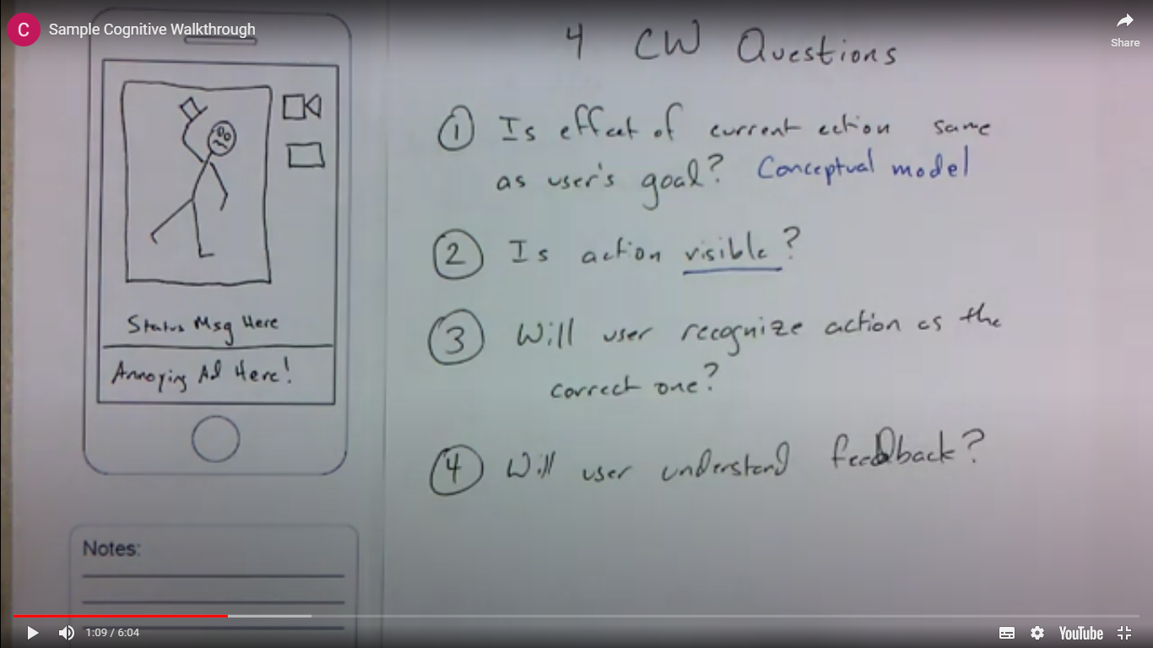

Slide 11
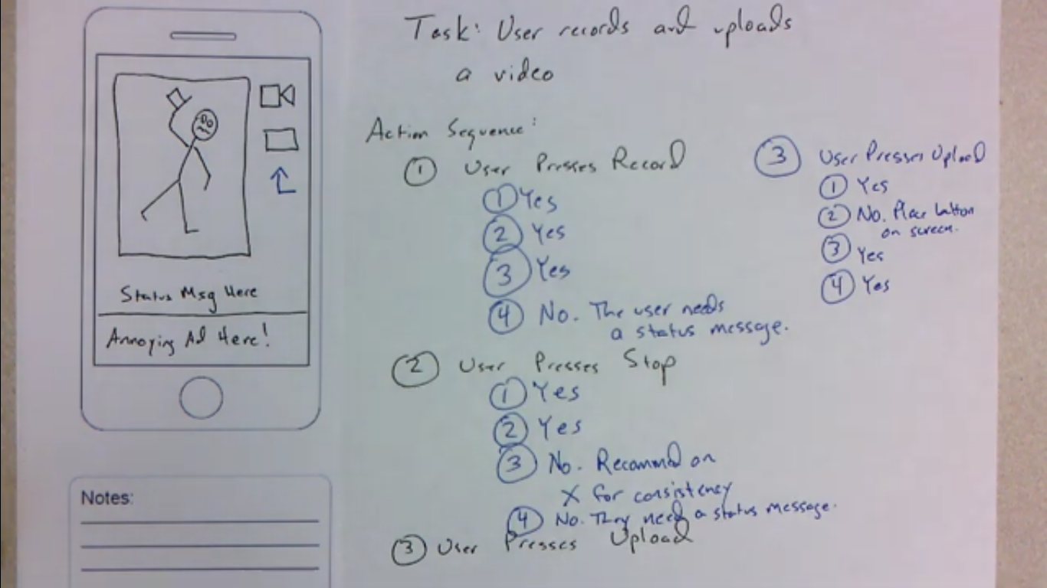

Slide 12
Analytics and A/B Testing
A variety of users’ actions can be recorded by software automatically, including
key presses
mouse or other pointing device movements
time spent searching a web page
looking at help systems
and task flow through software modules.

Slide 13
Web Analytics
Web analytics is a form of interaction logging that was specifically created to analyze users’ activity on websites so that designers could modify their designs to attract and retain customers.
Examples : Google Analytics, Moz Analytics, TruSocialMetrics, Clicky, KISSmertics, CrazyEgg, ClickTale

Slide 14
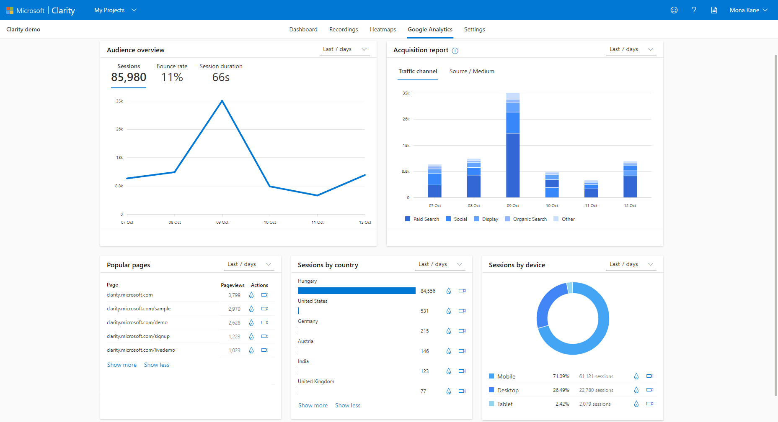
Web Analytics – Google

Slide 15
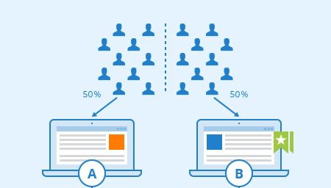
A/B Testing
A/B testing is a large-scale experiment to evaluate how two groups of users perform using two different designs - one of which acts as the control and the other as the experimental condition, that is, the new design being tested.

Slide 16
A/B Testing
Controlled experiment that often involves hundreds or thousands of participants.
A/B testing involves a “between subjects design”
To do A/B testing, a variable of interest is identified.

Slide 17
Predictive Model
Predictive models use formulas to derive various measures of user performance.
Predictive modeling provides estimates of the efficiency of different systems for various kinds of tasks.
Example: Fitt’s Law , Action Analysis

Slide 18
Fitt’s Law
Fitt’s law (Fitts, 1954) predicts the time it takes to reach a target using a pointing device.
In interaction design, it has been used to model the time it takes to point at a target based on the size of the object and the distance to the object.
It helps designers decide
where to locate physical or digital buttons,
what size to make them
and how close together to put them on a touch display or a physical device

Slide 19
Fitt’s Law
Fitts’ law states that:
T = klog2 ( D/S +1.0)
Where:
T = time to move the pointer to a target
D = distance between the pointer and the target
S = size of the target
And k is a constant of approximately 200 ms/bit.

Slide 20
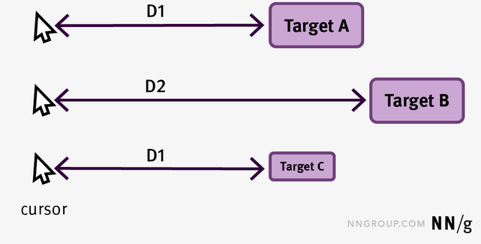
Fitt’s Law - Example

Slide 21
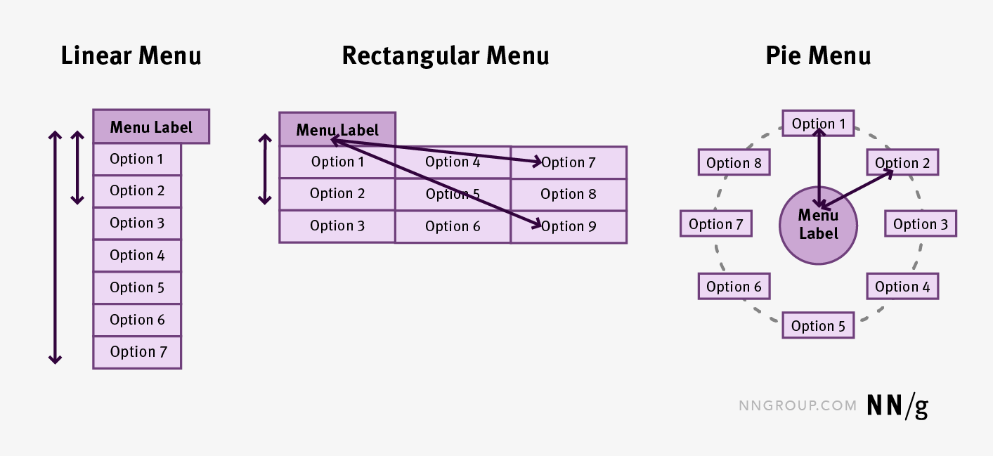
Fitt’s Law - Example

Slide 22
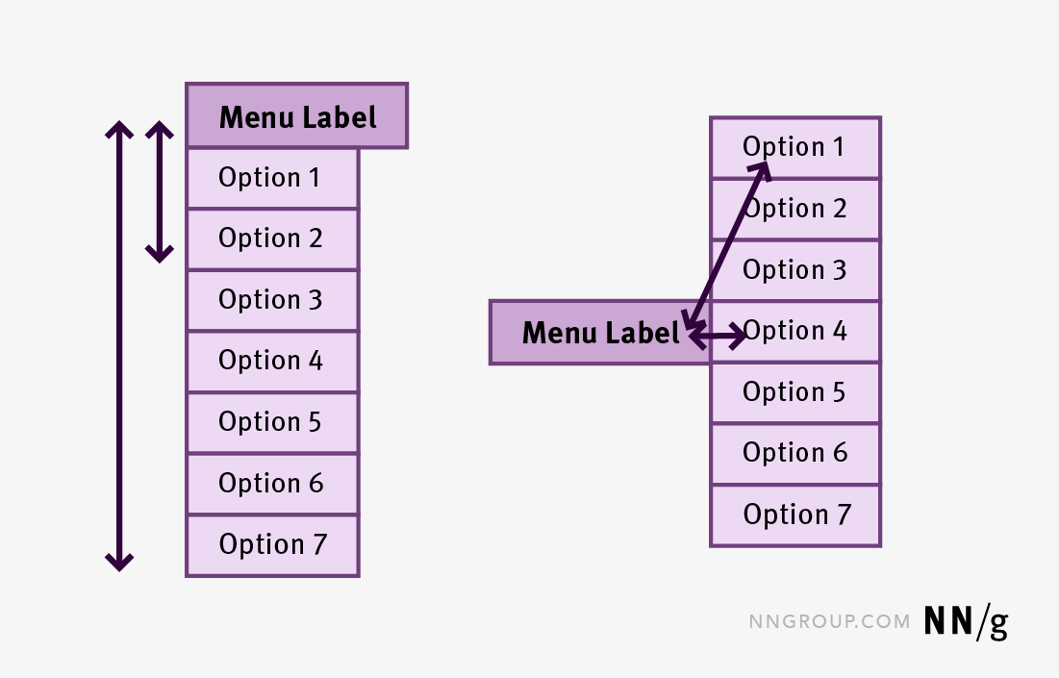
Fitt’s Law - Example

Slide 23
Action Analysis
Quantitative analysis of actions to predict the time a skilled user requires to complete tasks (efficiency).
Focus is on what the users actually do rather than on what they say they do.
Two flavors of Action Analysis (levels of detail):
Formal or “Keystroke-Level”
Informal or “Back-of-the-Envelope”

Slide 24
Conclusion
Inspection Methods
Analytics and A/B Testing
Predictive Models

